Slide 1
Generative LSTM
By 高強

Slide 2
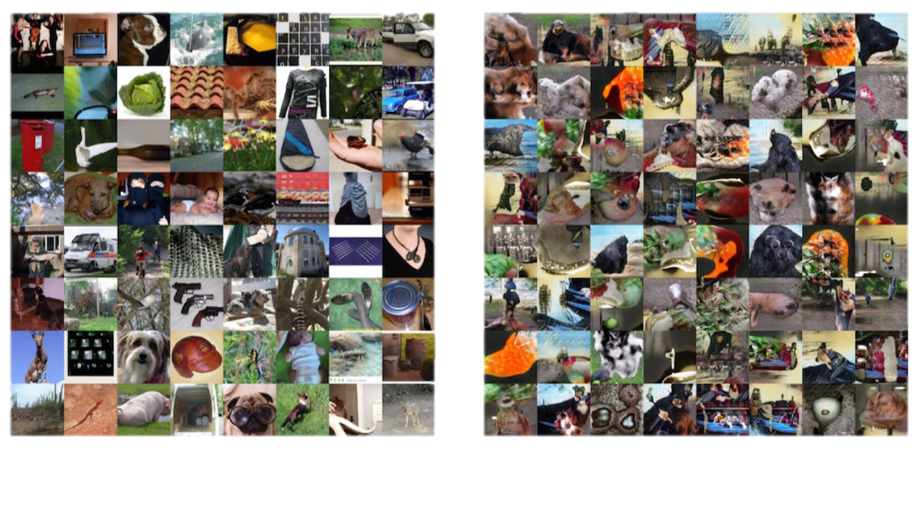
"GENERATIVE" ??
Real Images
Generated Images

Slide 3
"What I cannot create, I don't understand."
RICHARD FEYNMAN

Slide 4
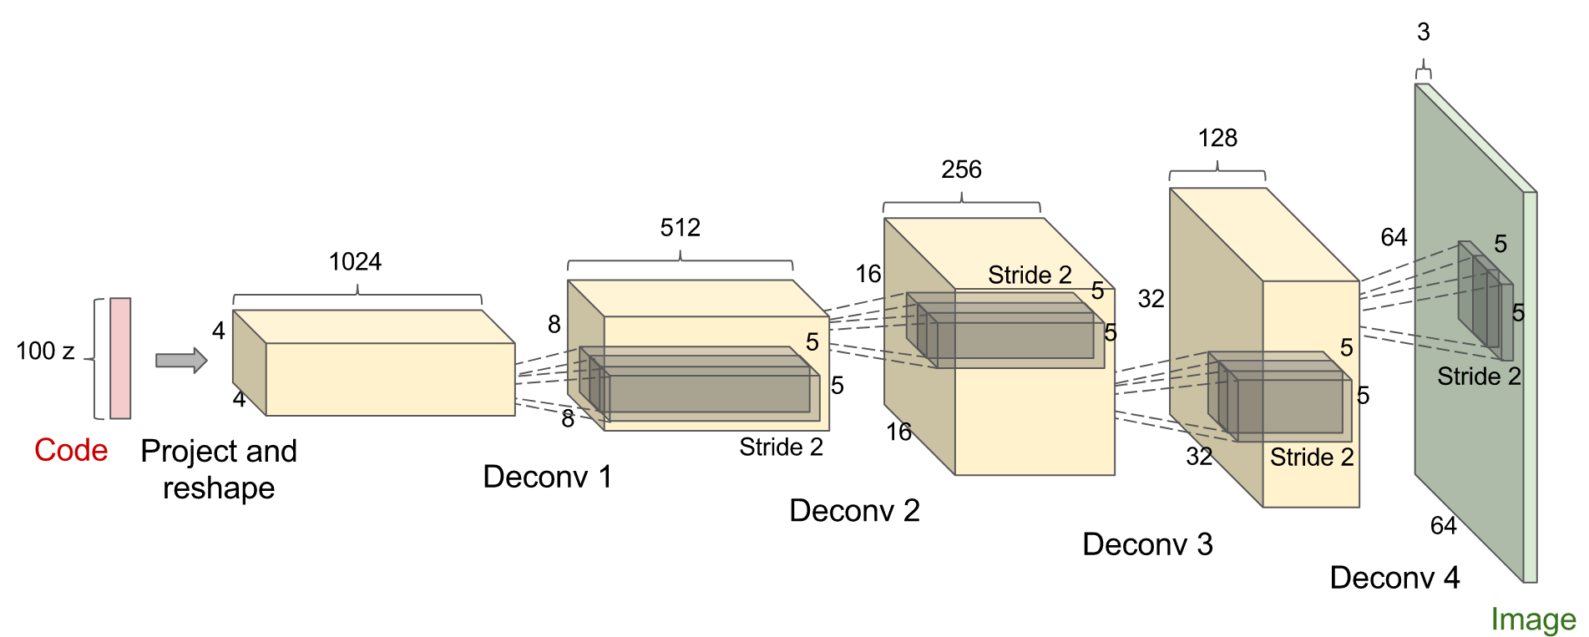
DCGAN
(DEEP CONVOLUTIONAL GENERATIVE ADVERSARIAL NETWORKS)

Slide 5
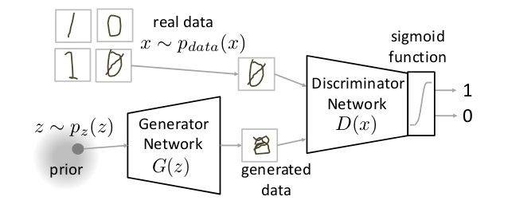
TRAINING A GENERATIVE MODEL
The discriminator is trying to distinguish real images from fake images and the generator is trying to create images that make the discriminator think they are real.

Slide 6
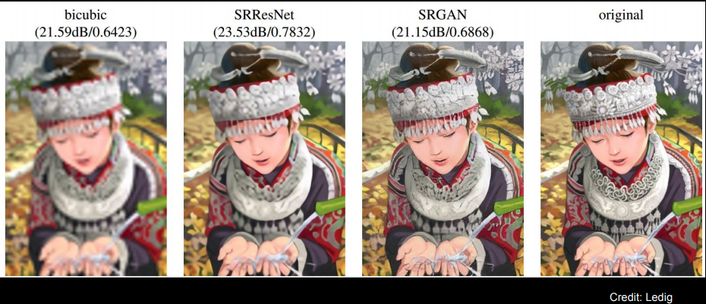
Apply

Slide 7
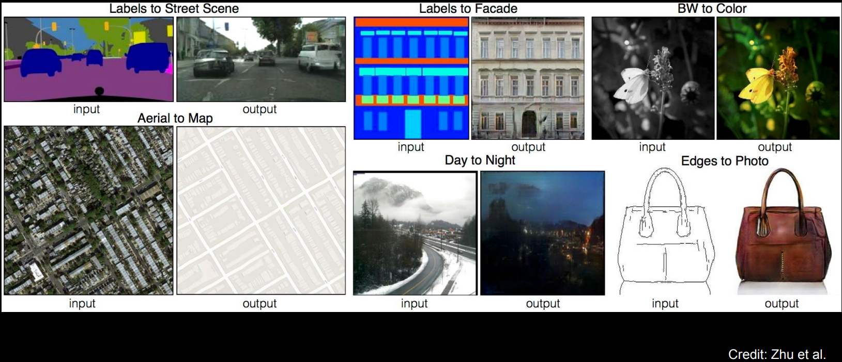
Apply

Slide 8
References
[1] https://blog.openai.com/generative-models/#contributions
[2] http://www.cs.toronto.edu/~slwang/generative_model.pdf
[3] Kingma, Diederik P., and Max Welling. "Auto-encoding variational bayes." arXiv preprint arXiv:1312.6114 (2013).

